Slide 1
AIR CRASH ANALYSIS
Airbus and Boeing

Slide 2
Introdution
In this analysis, The Cause of the accident, damages, Airlines and other facts are been analyzed.
Boeing and Airbus are considered for this study.
Boeing and Airbus are the most powerful commercial jets in the world
From 1990 to 2020, there were many major accidents happened due to many reasons.
From the analyzed data, Safest airlines and aircrafts can be found using data science.

Slide 3
Data
Collected data are from below sources.
Accident data source - aviation-safety.net
Aircraft Registrations - Wikipedia.com
Accident rates between Boeing and airbus aircrafts, accident rates between each types of aircraft, locations where accident happened, reasons for the accidents are analyzed in this study.
Below tools are been used for the analysis,
Geocoder to get location address, latitude and longitude.
Folium to point the accident places in the map.
Foursquare to find near affectable places.

Slide 4
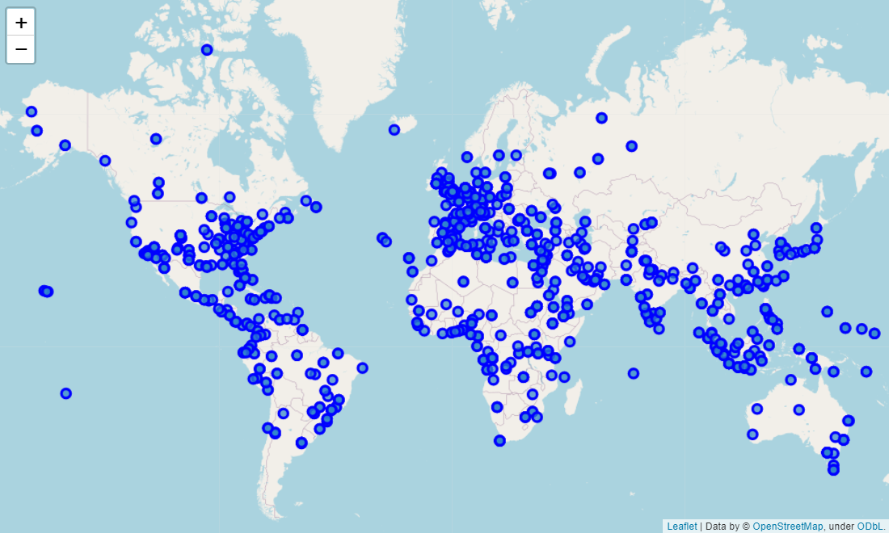
Data Analysis and Visualization
Reported total death is higher than 15000, starting from year 1990.
Air accidents are considered to be riskier than land accidents.
Death due to air accident can’t be predicted as counts of death per accidents are really high.
Aircrafts manufactured by Airbus and Boeing encounter 30 air accidents averagely per year.
Necessary precautions have to be taken by Authority and Manufacturing companies.

Slide 5
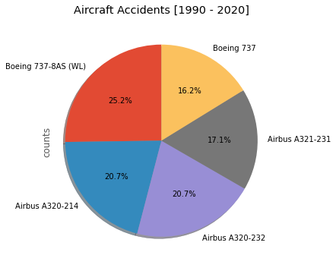
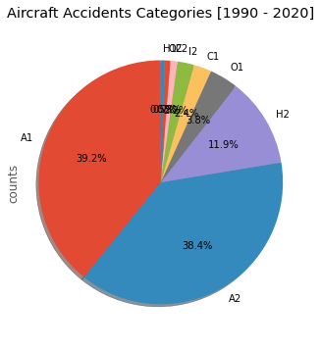

Slide 6
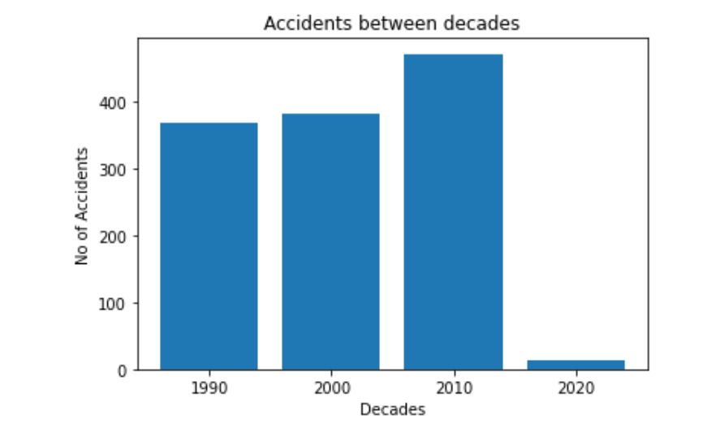
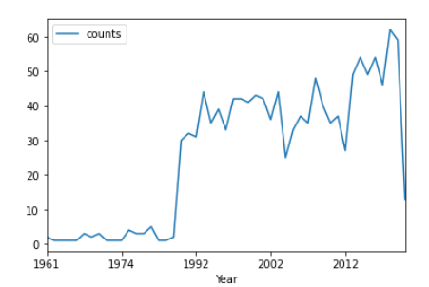
1990’s: 369, 2000’s : 383 , 2010’s: 472 , 2020 : 13

Slide 7
Model Development -Aircraft Damage
Accuracy of this model is 90.66%.

Slide 8
Model Development -Injury Severity
Accuracy of this model is 94.66%.

Slide 9
Results and Discussion
from the data we can see some factors give huge impact on these accidents, those are Investigation Type, Engine Type, Weather Condition, Broad Phase of Flight and Number of Engines. from these data we can predict if accident or incident happens, will it minor or major accident.
To implement the model, Decision Tree method was used.
Foursquare method was used to get surrounded area of accident.

Slide 10
Conclusion
Purpose of this project is analysis the Air accidents and its factors. Decision Tree method was used and accuracy of the model is more than 90%. Here two models were made to predict Aircraft Damage and Injury Severity, respectively both have 90.66% and 94.66% accuracy. So model is good for predictions.
Most of the Accidents gives fatal damages to the Aircraft than Incident. number of Engines and Engine type also plays major roles in accidents. If number of engines are 4, then most of the accidents are unrecoverable.
Weather condition is also another key factor. if weather is under IMC, then damage will be huge and unpredictable weathers also will cause disaster. other than that, most of the accidents were happened while landings.

